Slide 1
Synthesizing Pseudoephedrine from Methamphetamine with LLVM
Jonathan Smith

Slide 2
About Me
Cybersecurity researcher and software engineer at Fortego
That’s it.

Slide 3
Meth is bad. Just like your code.
And just like meth, bad code is easier to find and more plentiful than Sudafed.

Slide 4
Pseudoephedrine is better, like your code could be.
In fact, you don’t even have to re-write your code to be better. LLVM can be used to do that for you.
So don’t worry. Even though you’re a bad person for writing bad code, everything can be fixed.

Slide 5
What is LLVM?
Source code (C, C++, Objective C, Rust, etc.)
↓
Intermediate Representation (IR)
↓
Machine Intermediate Representation (Machine IR)
↓
Assembly
↓
Object code
↓
Final linkage/executable

Slide 6
Clang, LLD, and LLDB
Clang – Compiler front-end for LLVM (C, C++, Objective-C, etc.)
LLD – LLVM’s final executable linker with LTO support
LLDB – High performance debugger with a Python API

Slide 7
Everything is a library
Every tool is a wrapper around multiple libraries.
Every stitch of code is released under a permissive license.

Slide 8
<DISCLAIMER>
Everything I’m about to show you is not illegal, but it probably should be.
If you use any of this code in critical environments, people are going to die, and you will be charged with murder at The Hague – not me.
</DISCLAIMER>

Slide 9
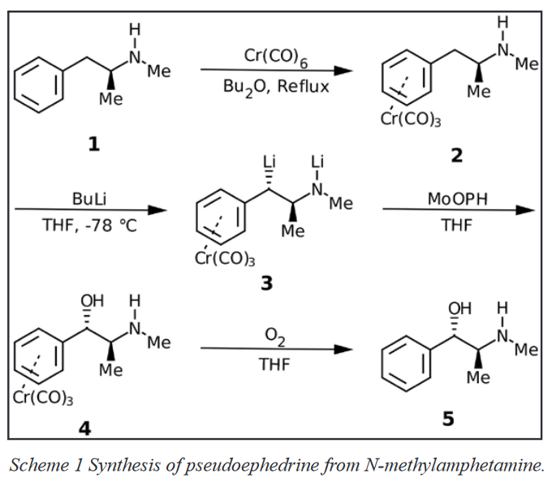
Also…
https://www.improbable.com/airchives/paperair/volume19/v19i3/Pseudoephedrine.pdf

Slide 10
Let’s Uncook.

Slide 11
Unwieldy Function Sizes
Problem:
Sometimes, we make functions much larger and more complex than they need to be.
This can lead to situations where code is duplicated when it doesn’t need to be.
Solution:
Break functions into smaller units by promoting every logical code block to its own function.

Slide 12
All code at:
https://github.com/jvstech/pseudo-passes

Slide 13
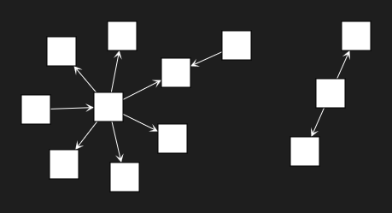
Unwieldy Function Sizes https://github.com/jvstech/pseudo-passes/tree/master/lib/passes/promote-blocks
Marat Tanalin IntegerScaling library (https://github.com/Marat-Tanalin/integer-scaling/tree/master/cpp)

Slide 14
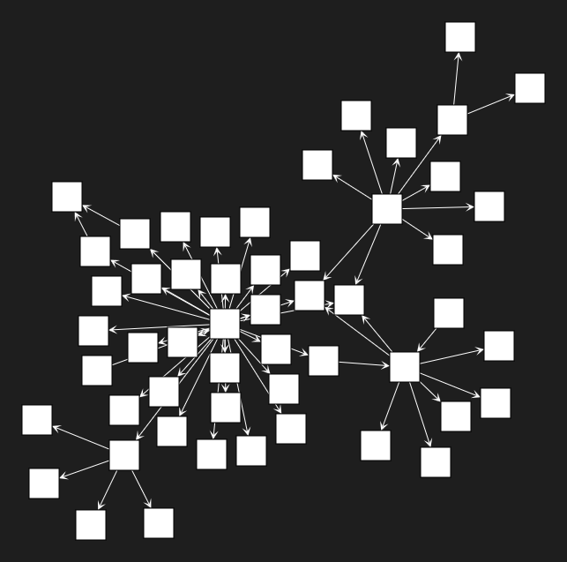
Unwieldy Function Sizes https://github.com/jvstech/pseudo-passes/tree/master/lib/passes/promote-blocks
clang++ -emit-llvm -O0 -Xclang --disable-O0-optnone -c IntegerScaling.cpp -o IntegerScaling.bc
opt --load-pass-plugin=promote-blocks.dll --passes="promote-blocks" IntegerScaling.bc -o IntegerScaling.post.bc
clang IntegerScaling.post.bc -o IntegerScaling.o

Slide 15
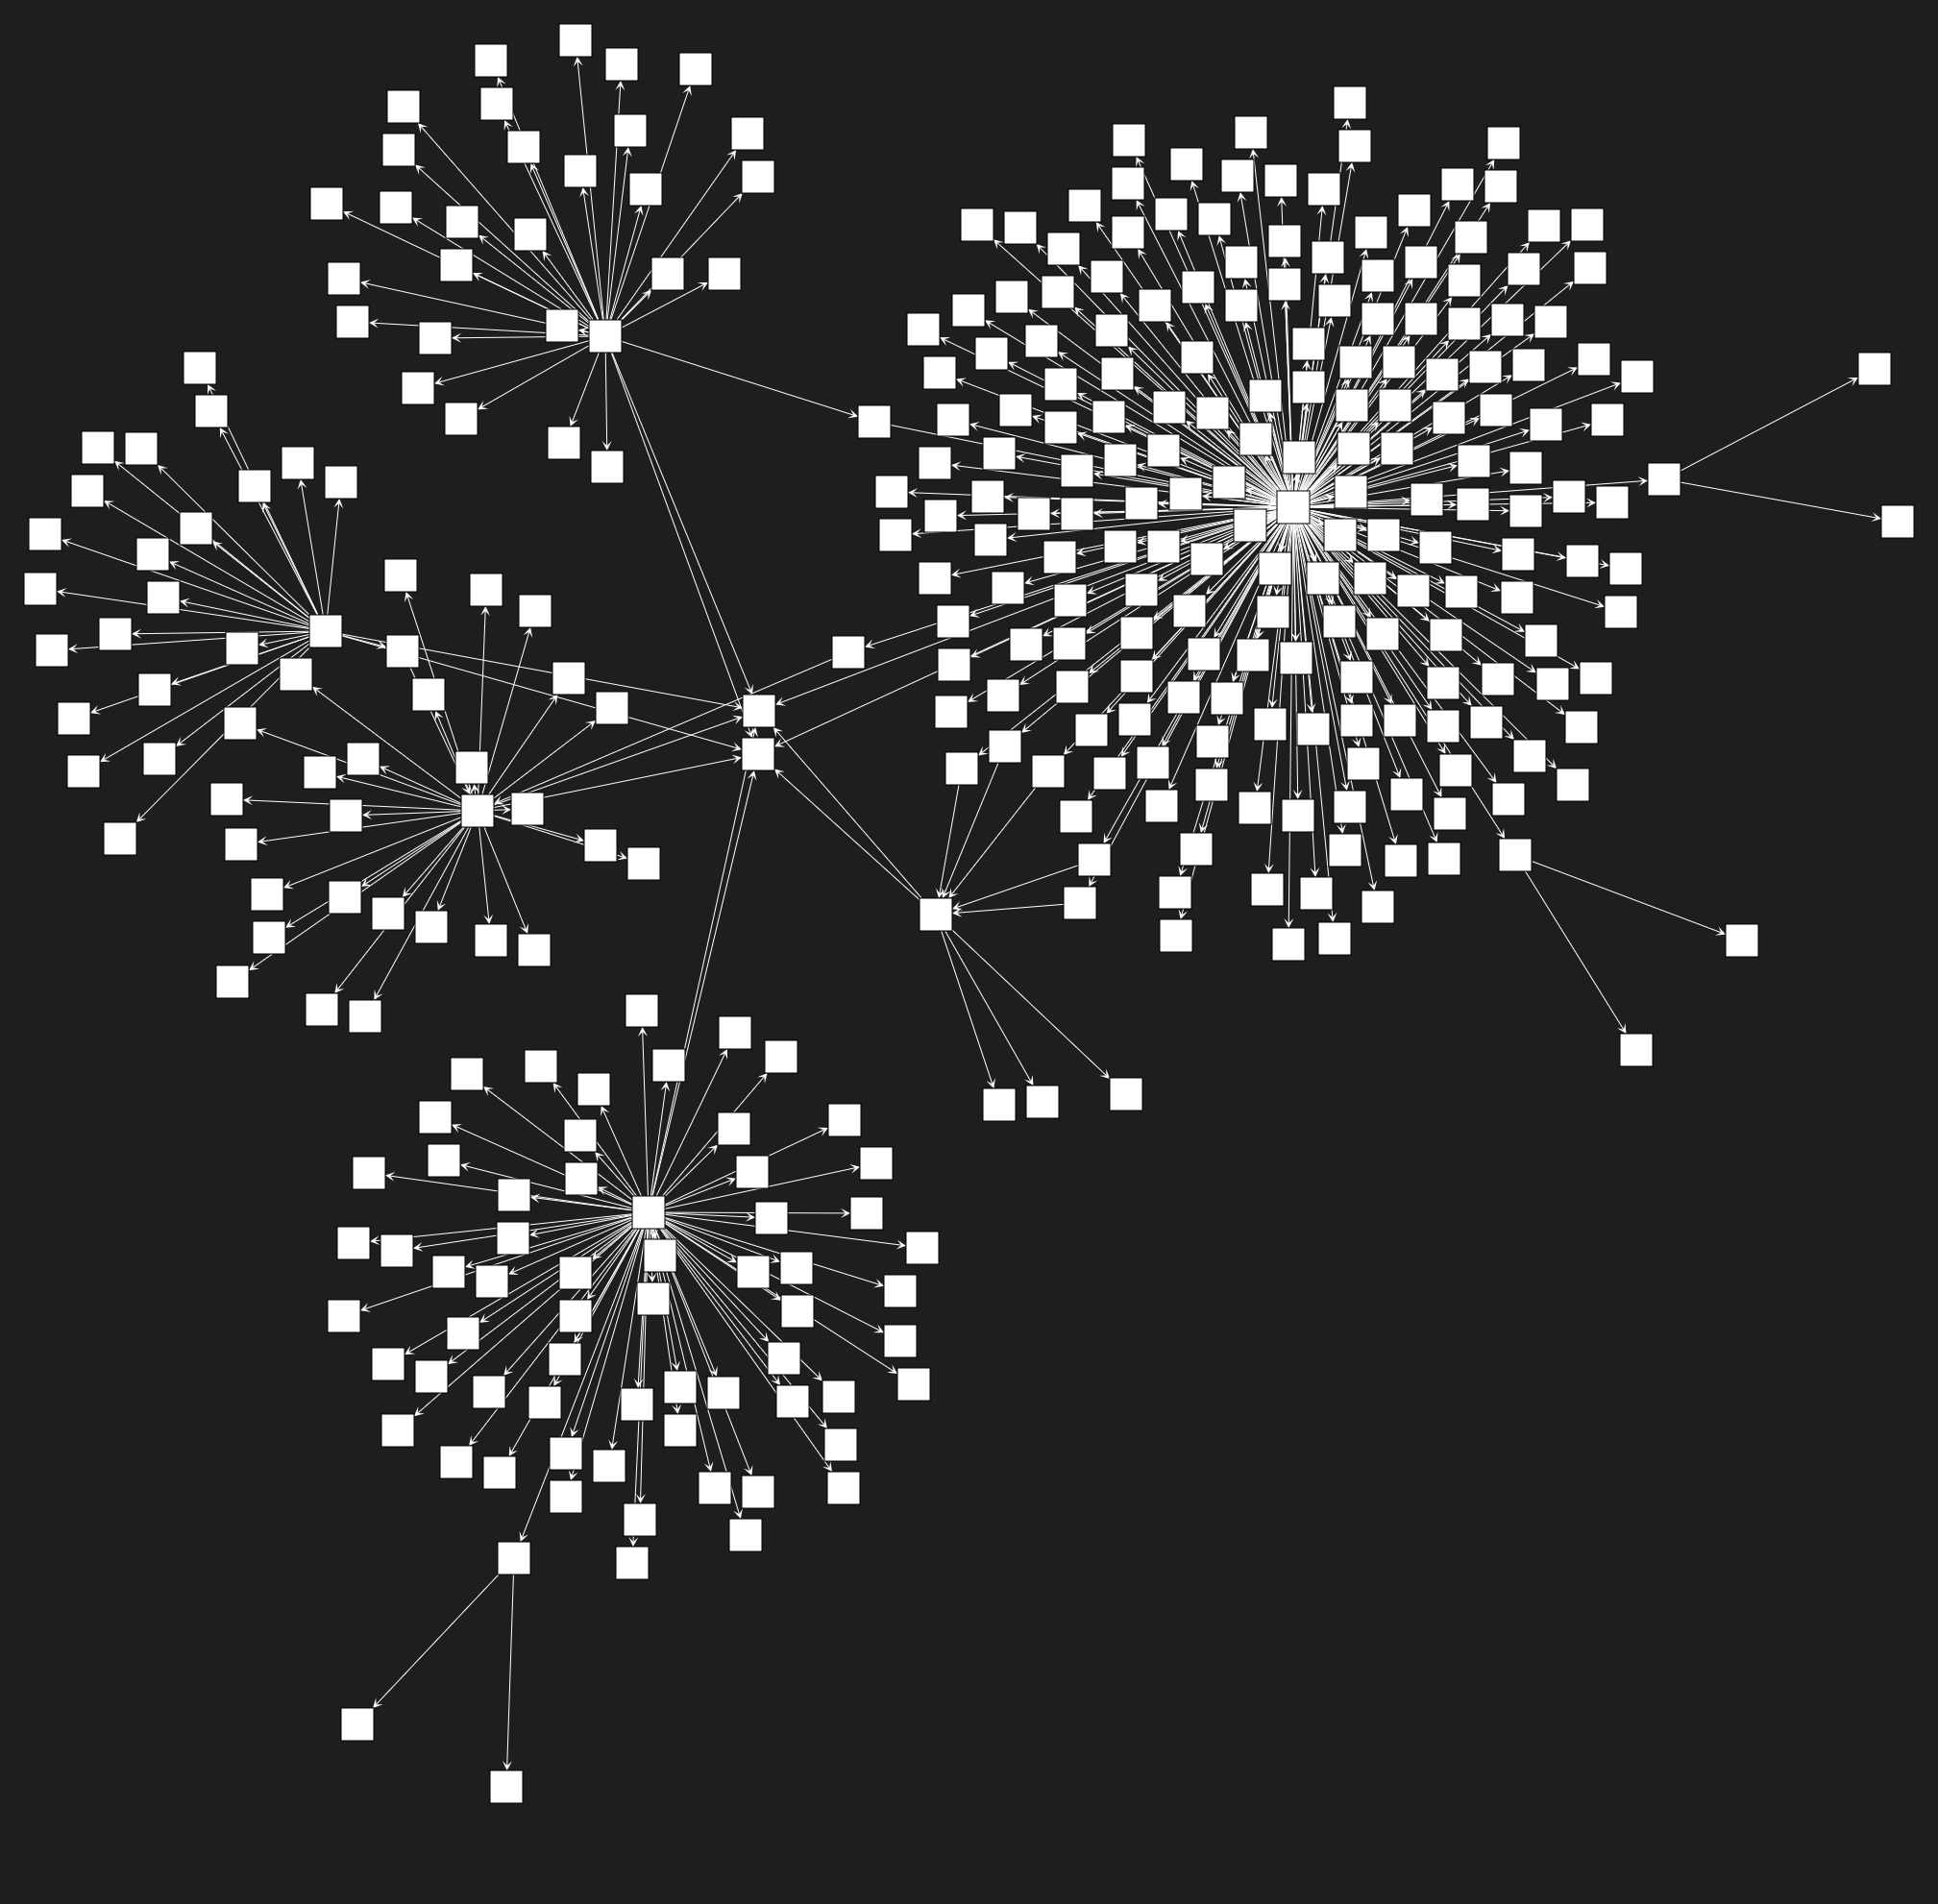
Unwieldy Function Sizes https://github.com/jvstech/pseudo-passes/tree/master/lib/passes/promote-blocks
clang++ -emit-llvm -O0 -Xclang --disable-O0-optnone -c IntegerScaling.cpp -o IntegerScaling.bc
opt --load-pass-plugin=promote-blocks.dll --passes="promote-instructions" IntegerScaling.bc -o IntegerScaling.post.bc
clang IntegerScaling.post.bc -o IntegerScaling.o

Slide 16
Expensive Function Calling https://github.com/jvstech/pseudo-passes/tree/master/lib/passes/fuse-functions
Problem:
Calling functions is a pricey operation. It requires dereferencing memory and messes with the stack.
Solution:
Remove all internal function calls by inlining callees everywhere they’re used.

Slide 17
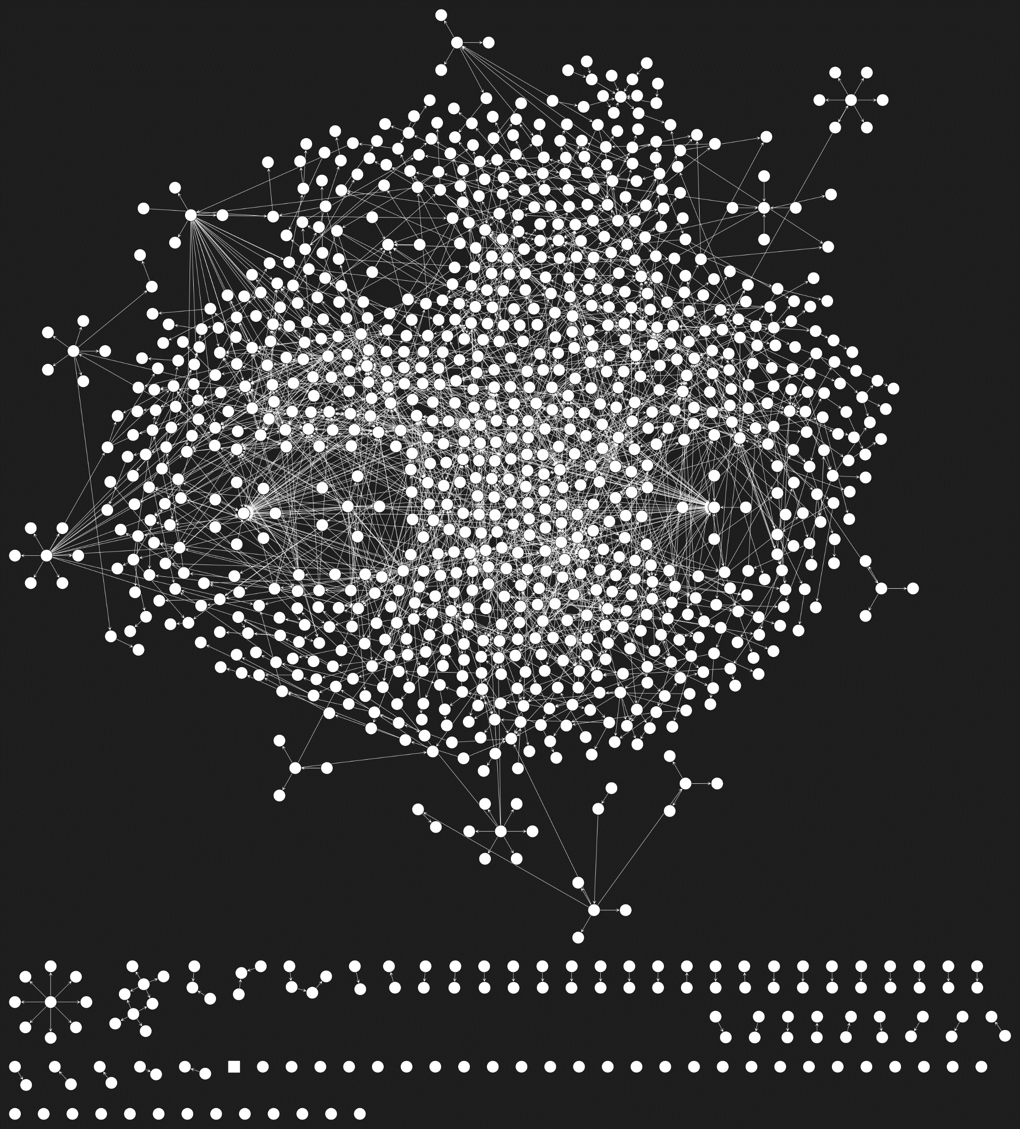
Expensive Function Calling https://github.com/jvstech/pseudo-passes/tree/master/lib/passes/fuse-functions
7zip-cpp (https://github.com/getnamo/7zip-cpp)
Function count:
1442
Size:
643 KB

Slide 18

Expensive Function Calling https://github.com/jvstech/pseudo-passes/tree/master/lib/passes/fuse-functions
7zip-cpp (https://github.com/getnamo/7zip-cpp)
Function count:
344
Size:
1552 KB

Slide 19
Flexible Debug Patch Points https://github.com/jvstech/pseudo-passes/tree/master/lib/passes/pachinko-calls
Problem:
While debugging, you may want to change a callee target to see how two functions handle input. In these situations, it can be a pain to change a call operand to point to the function you want.
Solution:
Change all direct calls to indirect calls. It’s far easier to change a register value while debugging.

Slide 20
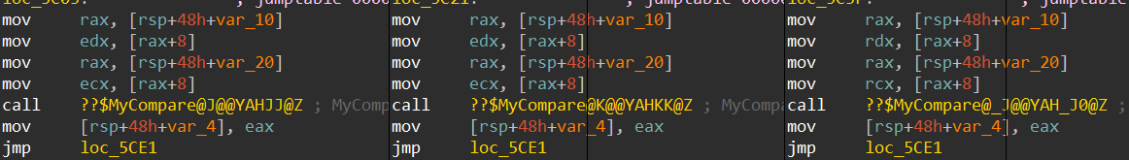
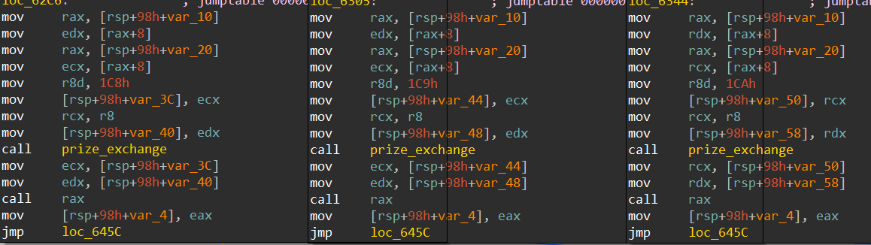
Flexible Debug Patch Points https://github.com/jvstech/pseudo-passes/tree/master/lib/passes/pachinko-calls

Slide 21

Flexible Debug Patch Points https://github.com/jvstech/pseudo-passes/tree/master/lib/passes/pachinko-calls
Before
After

Slide 22
Rigorous Debugging https://github.com/jvstech/pseudo-passes/tree/master/lib/passes/breakpoint-net
Problem:
When debugging, you may accidentally skip over an entire section of code you meant to step through because you forgot to set a breakpoint.
Solution:
Insert breakpoint interrupts after every instruction in the entire program.

Slide 23
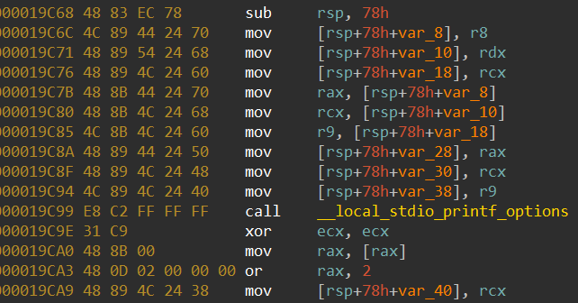
Rigorous Debugging https://github.com/jvstech/pseudo-passes/tree/master/lib/passes/breakpoint-net
Before:

Slide 24
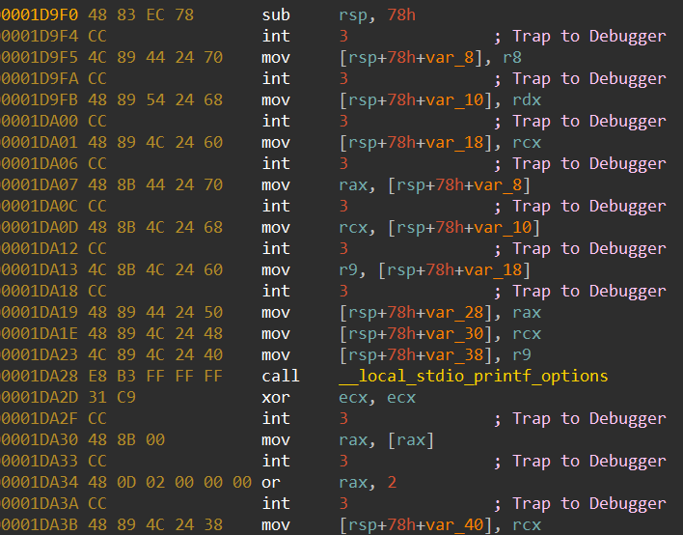
Rigorous Debugging https://github.com/jvstech/pseudo-passes/tree/master/lib/passes/breakpoint-net
After:

Slide 25
Stack Bloat https://github.com/jvstech/pseudo-passes/tree/master/lib/passes/stack-to-global
Problem:
Having variables and numbers all over your program is messy because it means you have data mixed in with your code. It also bloats your stack unnecessarily.
Solution:
Convert all operands to global values. This ensures your data stays in its own section where it can quickly be referenced, and you’ll know your code sections contain just that – only code.

Slide 26
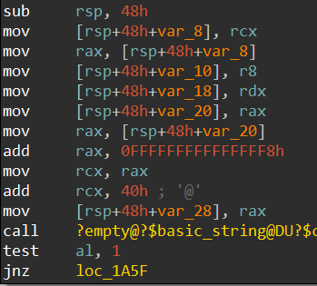
Stack Bloat https://github.com/jvstech/pseudo-passes/tree/master/lib/passes/stack-to-global
Before (Allocation: 72 bytes; Symbols: 1976)

Slide 27
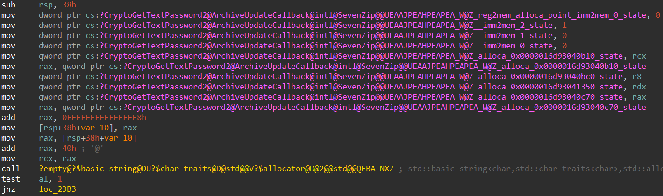
Stack Bloat https://github.com/jvstech/pseudo-passes/tree/master/lib/passes/stack-to-global
After (Allocation: 56 bytes; Symbols: 6799)
16 bytes saved from stack allocation!

Slide 28
Allocation Size Performance https://github.com/jvstech/pseudo-passes/tree/master/lib/passes/resize-malloc
Problem:
Allocations smaller than the smallest native page size waste precious RAM.
This causes memory fragmentation.
This also forces the CPU to waste cycles on unnecessary page management.
Solution:
Change all allocation sizes to multiples of at least 8K (can’t forget about UltraSPARC!)

Slide 29


Allocation Size Performance https://github.com/jvstech/pseudo-passes/tree/master/lib/passes/resize-malloc
int main(int argc, char** argv) { std::vector<int*> integers{}; std::cout << "Press enter when ready.\n"; std::cin.get();
for (int i = 0; i < 1000; ++i) { integers.push_back(reinterpret_cast<int*>(malloc(sizeof(int)))); }
std::cout << "Memory has been allocated. Press enter to release it.\n"; std::cin.get();
for (int* i : integers) { free(i); }
std::cout << "Memory has been released. Press enter to exit.\n"; std::cin.get(); return 0; }

Slide 30


Allocation Size Performance https://github.com/jvstech/pseudo-passes/tree/master/lib/passes/resize-malloc
Before:
After:

Slide 31
THANK YOU!
Questions?

